Slide 1




Adaptive Image Processing for Automated Structural Crack Detection
Melissa Becerra, Computer Science, University of Arizona
Dr. Hongki Jo, Civil Engineering and Engineering Mechanics
Dr. Jae-Hong Min, Civil Engineering and Engineering Mechanics
Kuiper Space Sciences Building, The University of Arizona
April 16, 2016

Slide 2
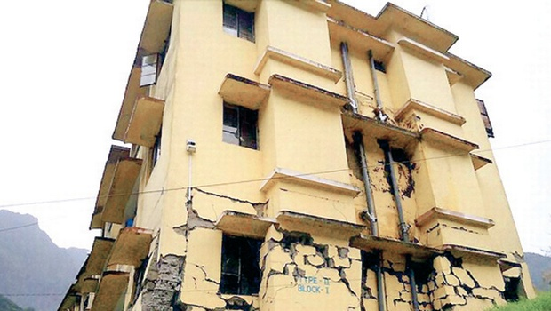
Problem: Deteriorating Concrete Structures
As structures get older, it is inevitable for them to deteriorate.
However, it is a civil engineer's task to keep buildings safe.
This involves sending engineers for visual inspection.
This method of detection becomes very costly.
Source:
http://www.newindianexpress.com/cities/chennai/2014/07/17/Scientists-to-Heal-Cracks-in-Buildings/article2333668.ece

Slide 3
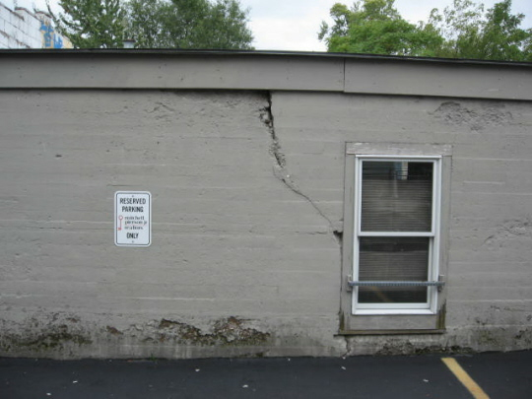
Objective: Crack Detection
Use image processing techniques to detect and measure a crack autonomously without the help of an engineer
Image processing: the analysis and manipulation of digitalized images by extracting "meaning" from pixels
Source: http://www.warreninspect.com/sag-settlement.html

Slide 4
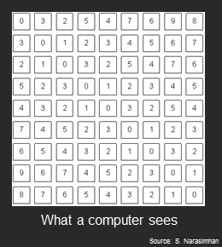
Analysis Techniques Using Image Processing
RGB images (color images) have 3 channels of pixel values.
Gray images and binary images each have 1 channel of pixel values.
Manipulating images involves changing individual pixel values.

Slide 5
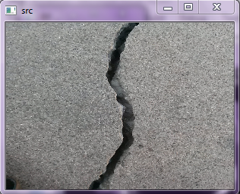
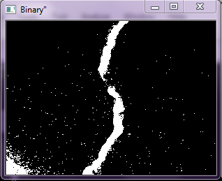
Analysis Techniques Using Image Processing
Some of the techniques used to detect cracks:
  Binary
  Grayscale
  Erode
  Dilate
  Smoothing
  BlackHat
  Skeleton
  Canny
  Etc.
Source: taken by Melissa Becerra, U of A Concrete Sidewalk

Slide 6

Analysis Techniques Using Image Processing
Using individual image processing techniques is insufficient to distinguish cracks from noise
With some techniques, removing noise can remove a part of the crack
The techniques must be combined to form a robust algorithm
Source:

Slide 7
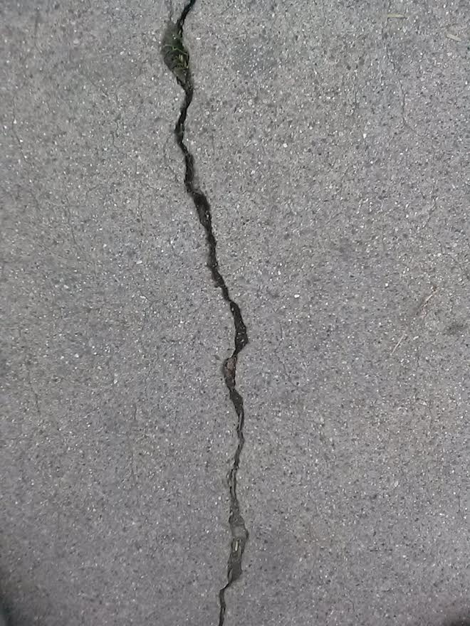
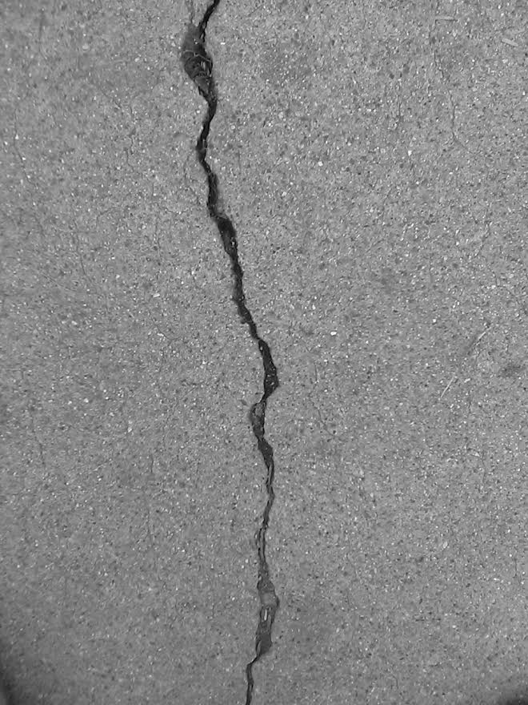

Results
source image gray image blurred image
Source: image taken by Melissa Becerra

Slide 8
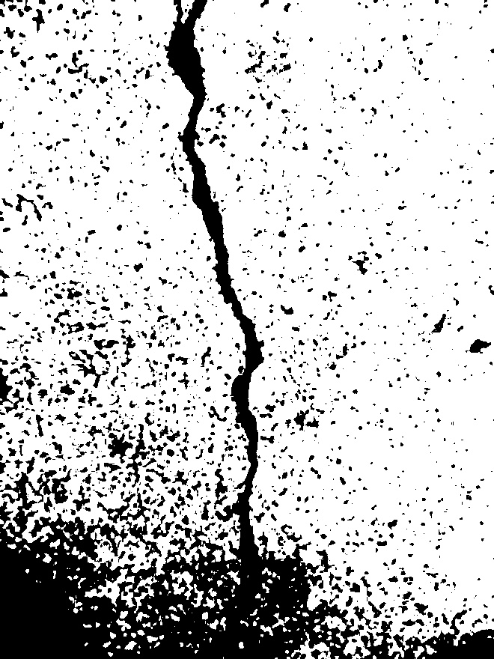
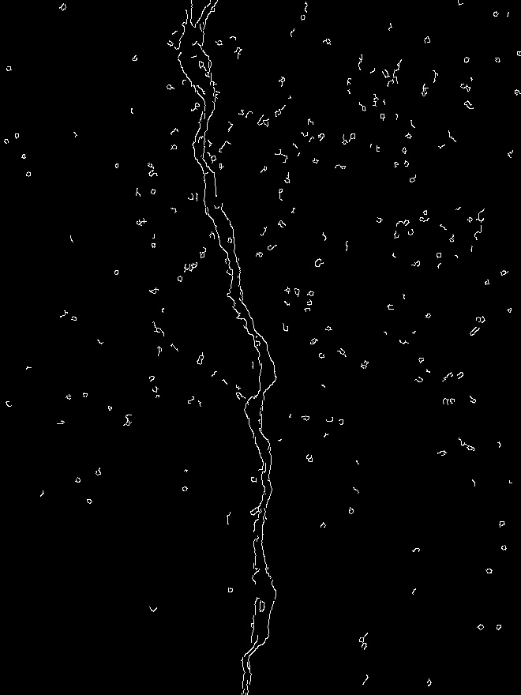
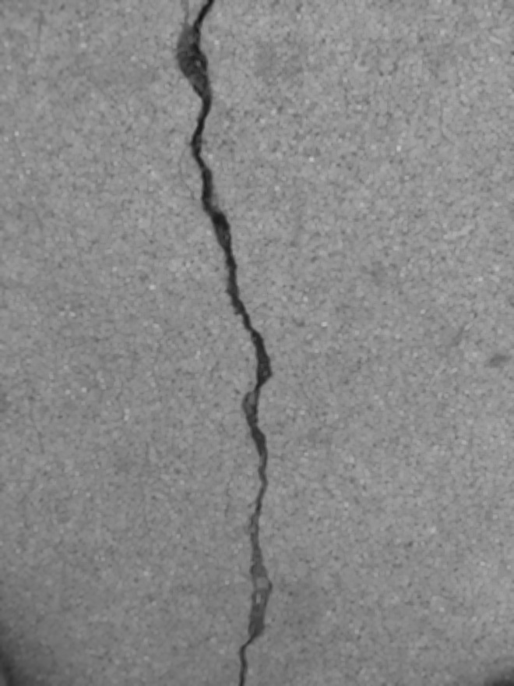
Results
otsu image canny image opening image
Source: image taken by Melissa Becerra

Slide 9

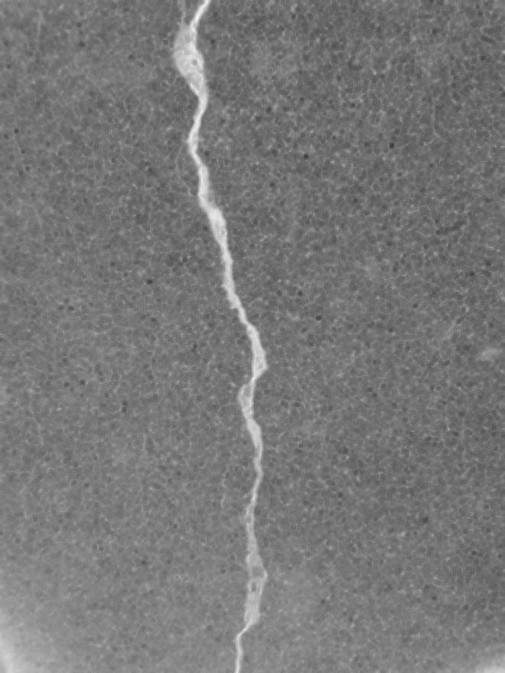
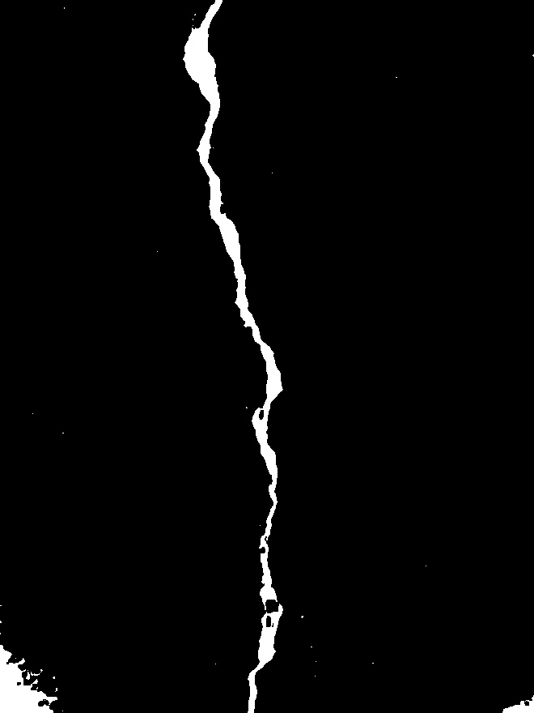
Results
black hat image black hat & opening image black hat & opening & binary image
Source: image taken by Melissa Becerra

Slide 10

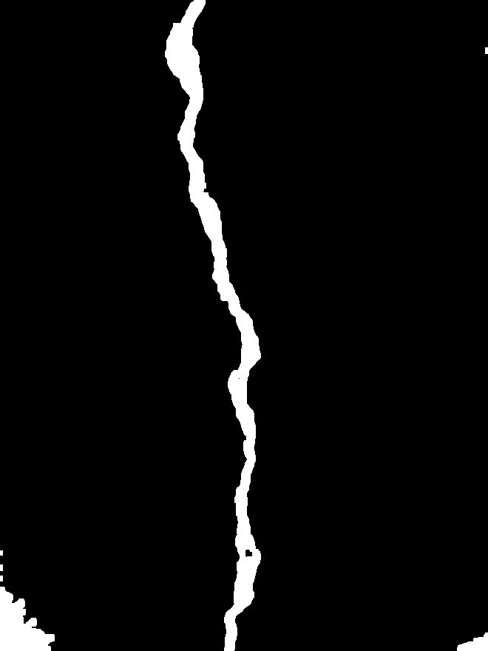

Results
filtered image (findContours) blurred filtered image thinning filtered (skeleton) iage
Source: image taken by Melissa Becerra

Slide 11
Conclusions
By combining different methods, we have been able to identify cracks more accurately
This research has made it possible to detect a crack's different widths using different threshold values and a spiral algorithm.
In the future, the chosen threshold values should be adjusted to improve autonomous detection
In doing so, this algorithm can be implemented into an existing phone application, RINO (Real-time Image-processing for Non-contact mOnitoring)

Slide 12
Acknowledgements
U of A Space Grant Consortium
Mentors: Dr. Hongki Jo
Dr. Jae-Hong Min
Smart Structures System Lab
NASA

Slide 13
Thank you

